Slide 1
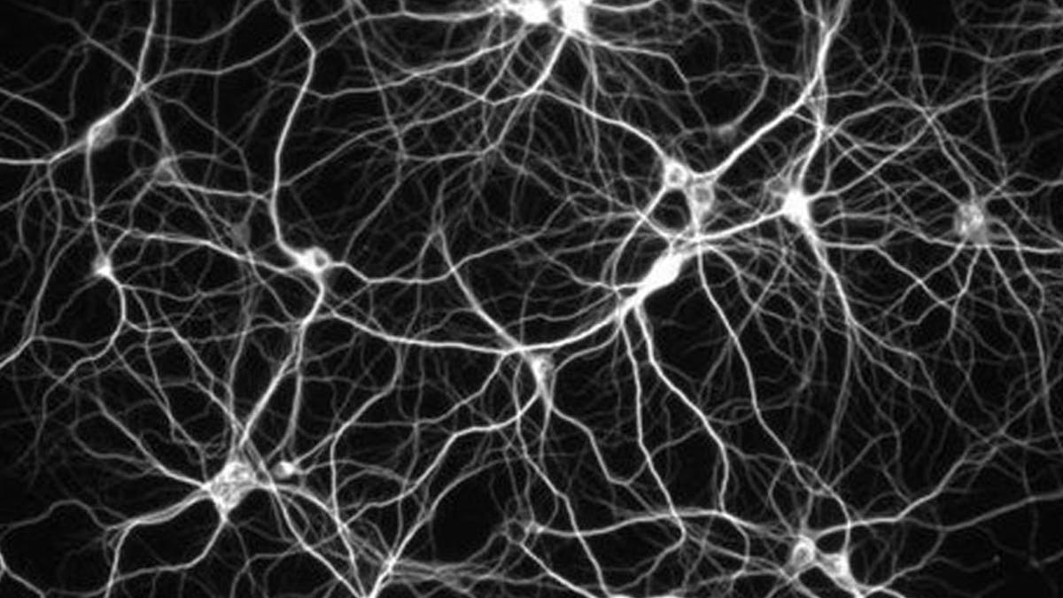

Slide 2
Artificial Neural Networks

